Slide 1

BANK ANALYTICS
Group 3 :
Vanithkumar S
Charan P
Vishwas S
Shreyas T L
Gaurav Tripathi
Shital V

Slide 2
WHY POWER BI
Power BI, Excel, and Tableau are all powerful tools used in data analytics, and the choice between them often depends on specific project requirements and preferences. Here's why Power BI might be preferred over Excel and Tableau for a bank loan analysis project:
Data Connectivity and Integration :
  Power BI : Power BI has extensive data connectivity options, allowing seamless integration with various data sources commonly used in banking, it has a ability to handle diverse data sources efficiently is beneficial in banking analytics.
  Excel: While Excel supports data connections, it might not handle large datasets or multiple sources as efficiently as Power BI.
  Tableau: Tableau also supports various data connections, but Power BI's integration with other Microsoft products and services can be advantageous in certain scenarios.

Slide 3
2. Data Modeling and Transformation:
  Power BI: Power BI excels in data transformation and modeling with Power Query Editor and Data Model. DAX enables advanced calculations.
  Excel: Excel has data modeling features, but Power BI's centralized Data Model and DAX functionalities provide more advanced capabilities.
  Tableau: Tableau also offers data modeling features, but Power BI's integration with Microsoft's data platform and tools can be advantageous for end-to-end data workflows.
3. Visualization and Reporting:
  Power BI: Power BI provides a user-friendly interface for creating interactive and visually appealing reports and dashboards. Its integration with other Microsoft products allows for seamless sharing and collaboration.
  Excel: Excel can create visualizations, but it may not be as interactive or dynamic as Power BI for creating comprehensive dashboards.
  Tableau: Tableau is renowned for its visualization capabilities, but Power BI's integration with the Microsoft ecosystem may be advantageous for organizations already using Microsoft tools.

Slide 4
4. Visualization and Reporting:
  Power BI: Power BI provides a user-friendly interface for creating interactive and visually appealing reports and dashboards. Its integration with other Microsoft products allows for seamless sharing and collaboration.
  Excel: Excel can create visualizations, but it may not be as interactive or dynamic as Power BI for creating comprehensive dashboards.
  Tableau: Tableau is renowned for its visualization capabilities, but Power BI's integration with the Microsoft ecosystem may be advantageous for organizations already using Microsoft tools.
5. Cost and Licensing:
  Power BI: Power BI offers a free version with limited features and a subscription-based Pro version. Its pricing can be competitive, especially for organizations already using Microsoft products.
  Excel: Excel is widely available, but certain advanced features may require additional licensing or add-ins.
  Tableau: Tableau tends to be pricier than Power BI, and its cost might be a factor in the decision-making process.

Slide 5
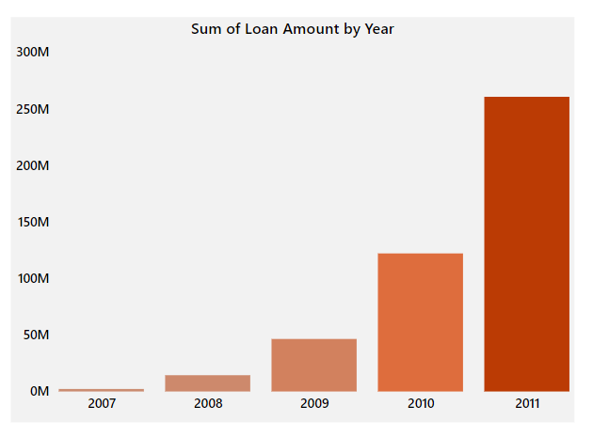
1. Year wise loan amount Stats
There is exponential growth of loan amount distribution expressed by the bank with respect to the year 2007 to 2011 grossing 2M to 261 Million.
The Loan Amount exhibits a direct proportionality to the year. The visual analysis unmistakably reveals a substantial increase in loan amounts in the upcoming years as well.
This also holds true for funded amount also. It means that bank aims to be profitable and hold good position in further years considering his growth.

Slide 6
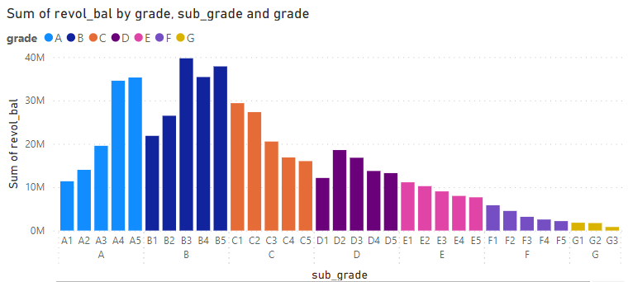
2. Grade and sub grade wise revol_bal
The balance that carries over from one month to the next is the revolving balance on that loan.
From the given graphs, we can easily conclude that B3 subgrade has highest sum of revolving balance while G5 has the lowest one. This means that borrowers having G grade has lowest accumulation of revolving credits.
A low revolving balance is generally considered better for financial health, because of low credit utilization, having low interest costs, minimal financial stress and high creditworthiness.

Slide 7
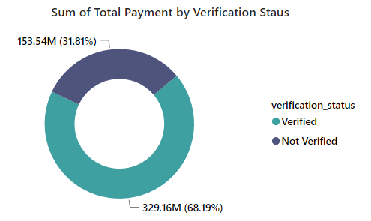
3. Total Payment for Verified Status Vs
Total Payment for Non Verified Status
Verification status resembles whether the borrower’s account is verified or non-verified.
Given graph states that around 68.19% Borrowers having the verified bank account (both verified and source verified) and 31.81% borrowers have the bank account which are not verified.
Also, around 329.16 Million of total payment received by the verified borrowers and remaining 153.5 million received by non-verified borrowers.
Still, bank has to put their eye on verified borrowers rather than non-verified and being cautious around non verified borrowers.

Slide 8
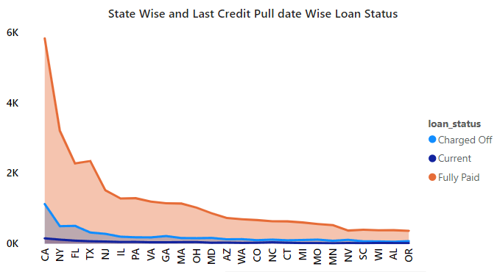
4. State wise & last_credit_pull_d wise loan status
This provides a concise overview of the loan portfolio's health. It reveals the distribution of loan statuses across states and tracks changes over time based on the last credit pull date.
Key insights include state-specific loan approval trends and variations in loan statuses over different credit pull dates, enabling informed decision-making for optimizing lending strategies.

Slide 9
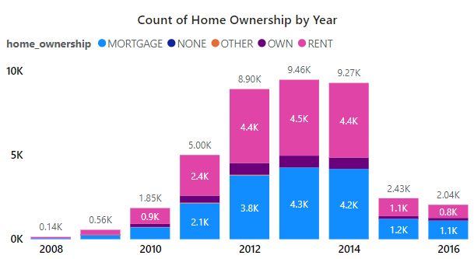
5. Home ownership Vs last payment date stats
This provides a concise overview of the relationship between home ownership status and the timing of the last payment.
By comparing data on home ownership against the last payment date, the KPI offers insights into payment behaviors among homeowners and non-homeowners.
This KPI serves as a valuable indicator for financial institutions and real estate professionals seeking to understand the impact of home ownership on payment habits.

Slide 10
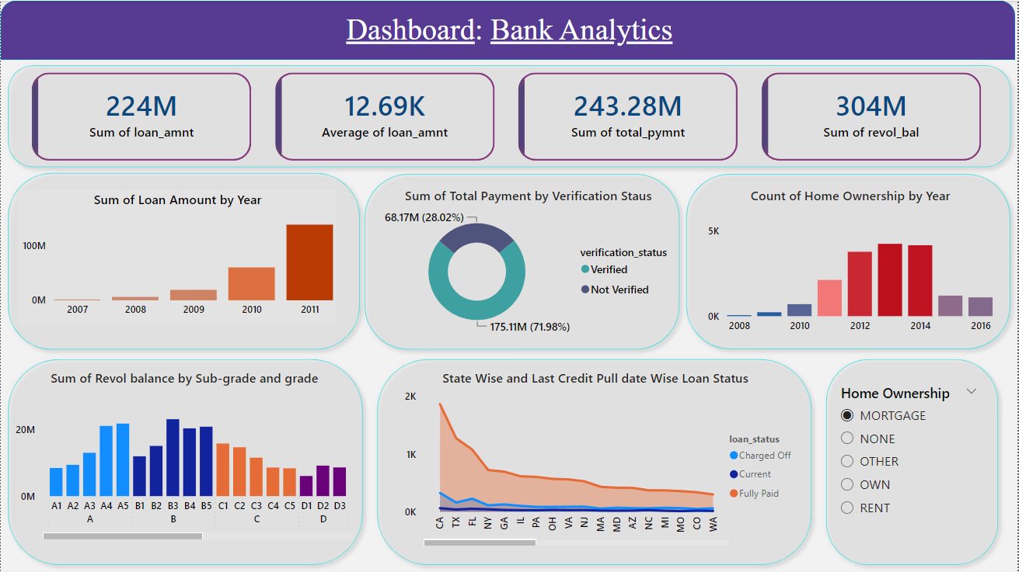
POWER BI DASHBOARD

Slide 11
RECOMMENDATIONS
After a comprehensive analysis, it's evident that the bank holds a profitable portfolio and a strong market position. However, there are key steps they can take to sustain profitability, such as effective risk management, efficient cost control, a customer-centric approach, interest rate management, and regular performance evaluation.
The bank is advised to concentrate on states where borrowers opt for loans with low interest rates, providing a competitive edge that fosters high customer retention, community engagement, and cross-selling opportunities
Additionally, the bank can enhance customer experience by launching online portals for banking privileges, including customer support, net banking, and regular reviews. Offering various government policies to borrowers will attract a larger customer base.
When it comes to home ownership, analyzing housing trends necessitates an understanding of factors driving homeownership, such as economic conditions, government policies, and demographic shifts.

Slide 12
CONCLUSIONS
In conclusion, the Bank Analytics Project conducted using Power BI has proven to be instrumental in gaining valuable insights into the bank's operations and customer behavior. Through meticulous data cleaning, transformation, and visualization techniques, the Power BI tool has enabled the creation of dynamic dashboards and reports.
The State-wise and Last Credit Pull Date-wise Loan Status KPIs have provided a comprehensive overview of the loan portfolio, shedding light on regional trends and temporal patterns in loan approvals and denials.
Additionally, the Home Ownership vs. Last Payment Date Stats KPI has allowed for a nuanced understanding of the relationship between housing status and payment behaviors.
The incorporation of interactive elements like slicers enhances user engagement and customization, while the emphasis on data quality ensures the reliability of the analytics.
Ultimately, the insights derived from this project empower decision-makers to make informed and strategic choices, optimizing the bank's lending strategies and customer relations

Slide 13

THANK YOU
Thank you, Excelr Solutions , for providing the exceptional Bank Analytics project domain. Your choice has been instrumental in enhancing our analytical skills and delivering meaningful insights. We appreciate the valuable opportunity to work on such a relevant and impactful project.

